Slide 1
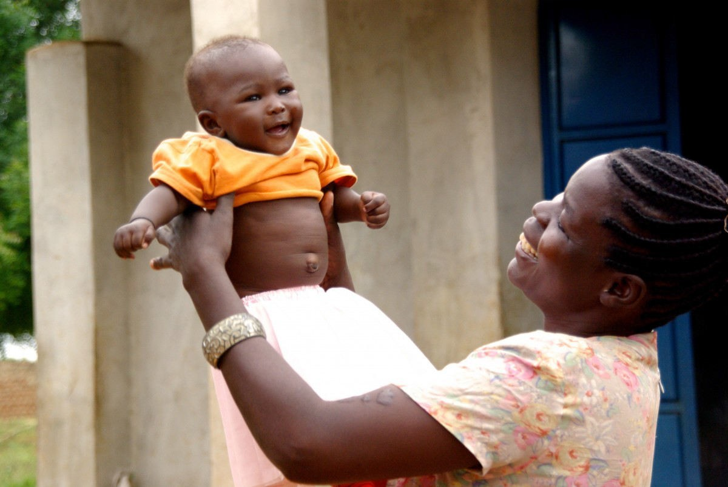

GNUHealth
Free SoftwaretechnologyimprovingPublicHealthcarearoundtheworld
Celebrating 10 years of Freedom and Equity in Healthcare
Efstathios Iosifidis, DVM
openSUSE member
iosifidis@opensuse.org
LuisFalcónMartín
GnuSolidario.
CC-BY-NC-SA4.0

Slide 2

GNUHealth:Freedom andEquityinHealth
GNU Health is a Social Project
...that uses really cool technology
LuisFalcónMartín
GnuSolidario.
CC-BY-NC-SA4.0

Slide 3
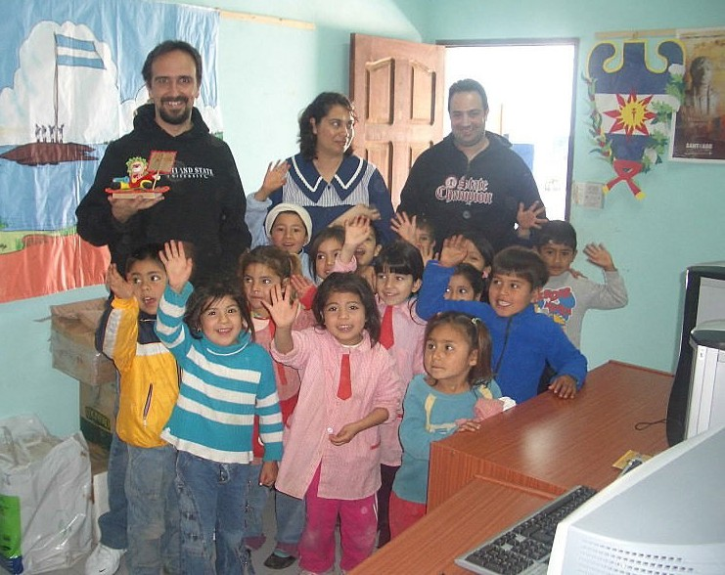

AboutGNUSolidario
“DeliveringHealthandEducationwith Free Software”
GNUHealth
TheFree HealthandHospital InformationSystem.(health.gnu.org)
GNUHealthCon-IWEEE InternationalWorkshoponE-Health inEmergingEconomies.
GNUSolidariofirstproject:SantiagodelEstero,Argentina,2006
LuisFalcónMartín
GnuSolidario.
CC-BY-NC-SA4.0

Slide 4
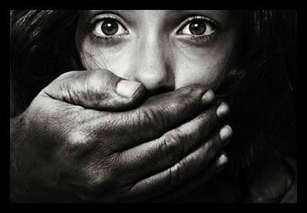
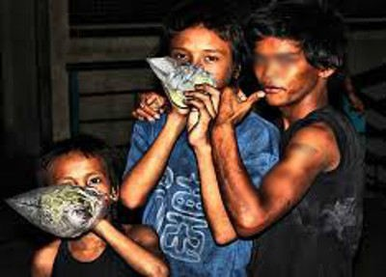
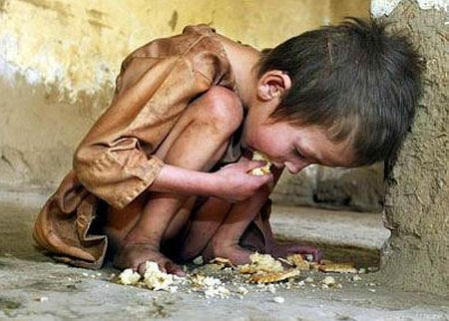
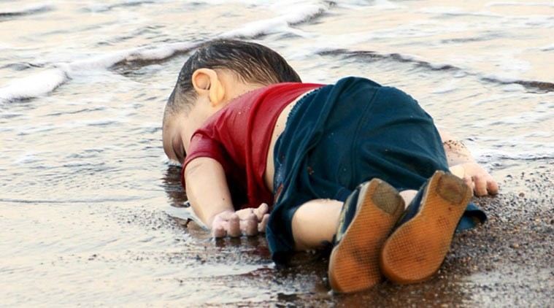
Over20000Childrendieeverydayfrom SocialDiseases–inmisery
HumanTrafficking ContaminatedWater Malnutrition Cholera Drugabuse Prostitution Chagas Tuberculosis ChildLabour
War FamilyViolence
Malaria HIV/AIDS
LuisFalcónMartín
GnuSolidario.
CC-BY-NC-SA4.0

Slide 5
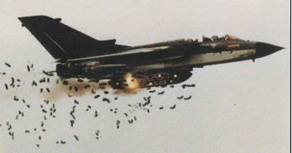
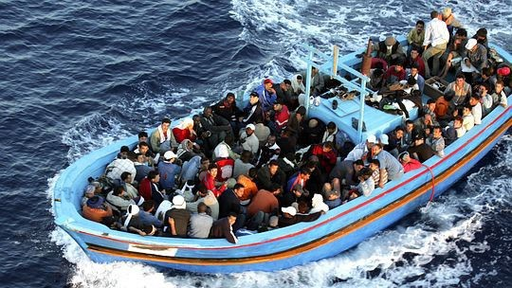

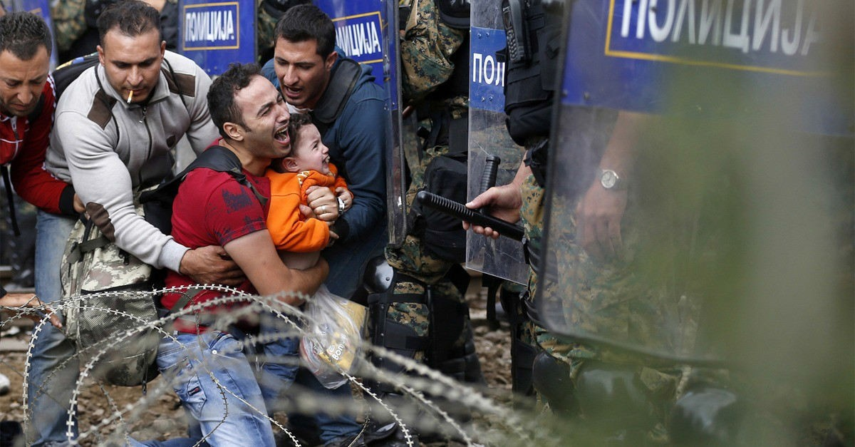
TheotherMiserables:Thosewhocausemisery
The macabre business of war
LuisFalcónMartín
GnuSolidario.
CC-BY-NC-SA4.0

Slide 6
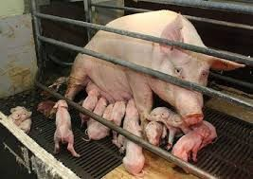
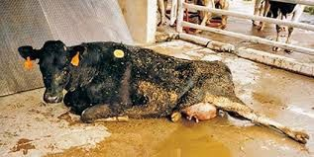
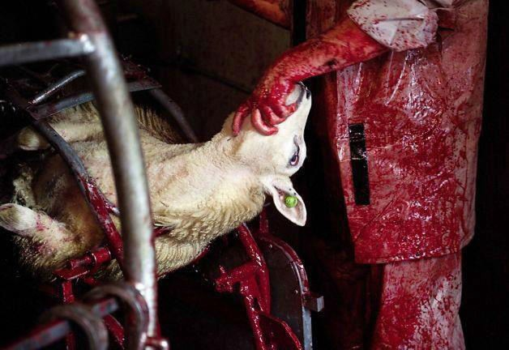
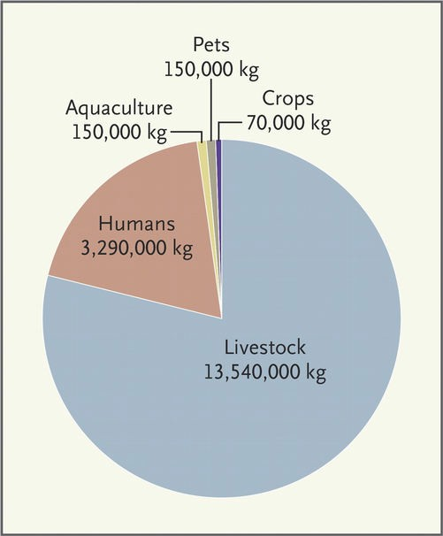
DairyandMeat:Inhumane,CruelandUnhealthy
Extremely cruel
Stress → immunocompromise → ATB → Resistance
Bacteria contamination
Milk / meat full with ATB, Hormones, …
Linked to cancer, cardiovascular disease in humans
Global warming
New England Journal of Medicine
Dec 26, 2013
Factory farming accounts for 37% of methane emissions, 20 times the global warming potential of CO₂
LuisFalcónMartín
GnuSolidario.
CC-BY-NC-SA4.0

Slide 7
GNUHealth:NatureandNurture
Current System of Disease (reductionist)
“GNU” System of Health
People before patients
biology
Biology
Govt / Community
Education
Disease
Meds
Biological Psychological Social
Patient
Nutrition
Exercise
expensive
Acute
Reactive
Invasive
Affection
Work
Housing
health.gnu.org
LuisFalcónMartín
GnuSolidario.
CC-BY-NC-SA4.0

Slide 8

GNUHealth:Functionality
PersonandCommunity
→Person,families
→DomiciliaryUnits,
→HealthInstitutions,profesionals
→Socioeconomics,lifestyle.
Patient
→Medicalhistory,Evaluations,ap ointments
→Genetics&familyhistory
→Prescriptions
→surgeries…
HealthInstitutionManagement
→Finances, Billing
→StockManagement,pharmacies
→Hospitalizations,Inpatientcomplex
→LIMS
→EmergencyManagement.
HealthAuthorities/MoH
* Civil/VitalRecordSystem
→Healthcampaigns
→Epidemiology
→Federation,distributedhealthnetworks.
LuisFalcónMartín
GnuSolidario.
CC-BY-NC-SA4.0

Slide 9











GNU Health is Free / Libre Software
Official GNU Package, from the Free Software Foundation
OpenDocumentation Relies on free technology
Internationalcommunity(100+languageteams)
LuisFalcónMartín
GnuSolidario.
CC-BY-NC-SA4.0

Slide 10
health.gnu.org
Demographics CommunityandInfrastructure
LuisFalcónMartín
GnuSolidario.
CC-BY-NC-SA4.0

Slide 11
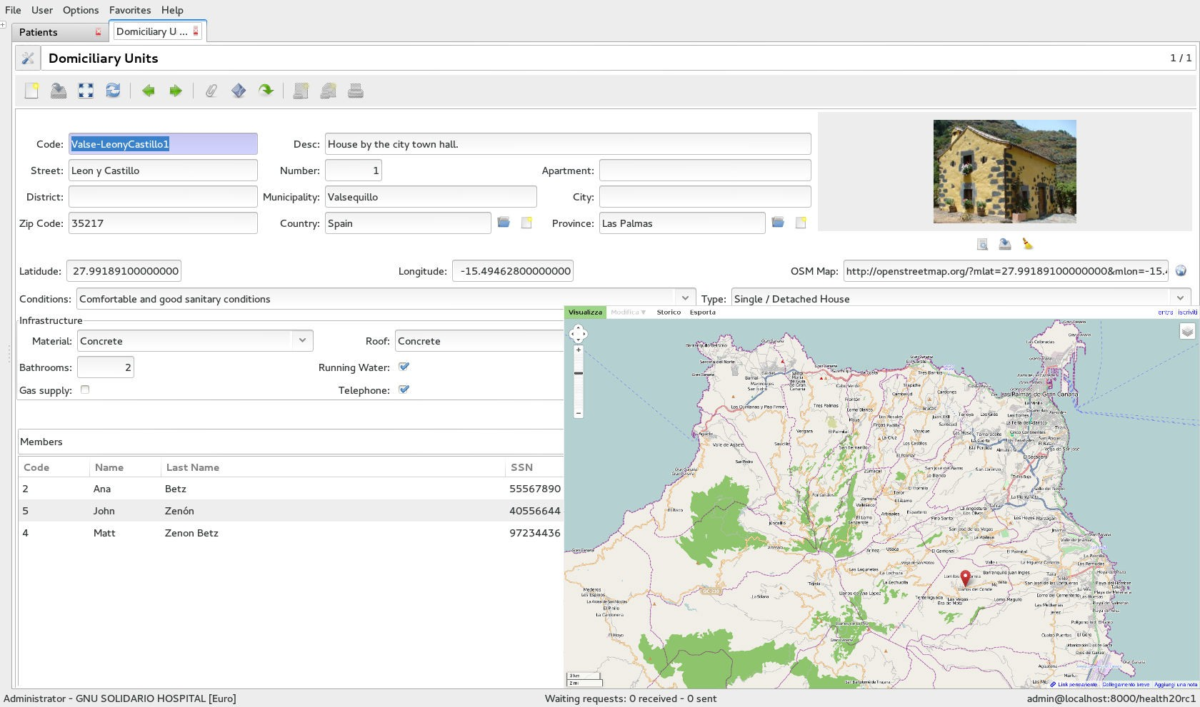
TheDomiciliaryUnits(DUs)
Address / Location Construction material Number of rooms
Sanitary conditions
Bathrooms Sewers Electricity
...
The DU shows the people currently living in it at any given moment The DU can be geolocated / linked to OpenStreetMap
LuisFalcónMartín
GnuSolidario.
CC-BY-NC-SA4.0

Slide 12
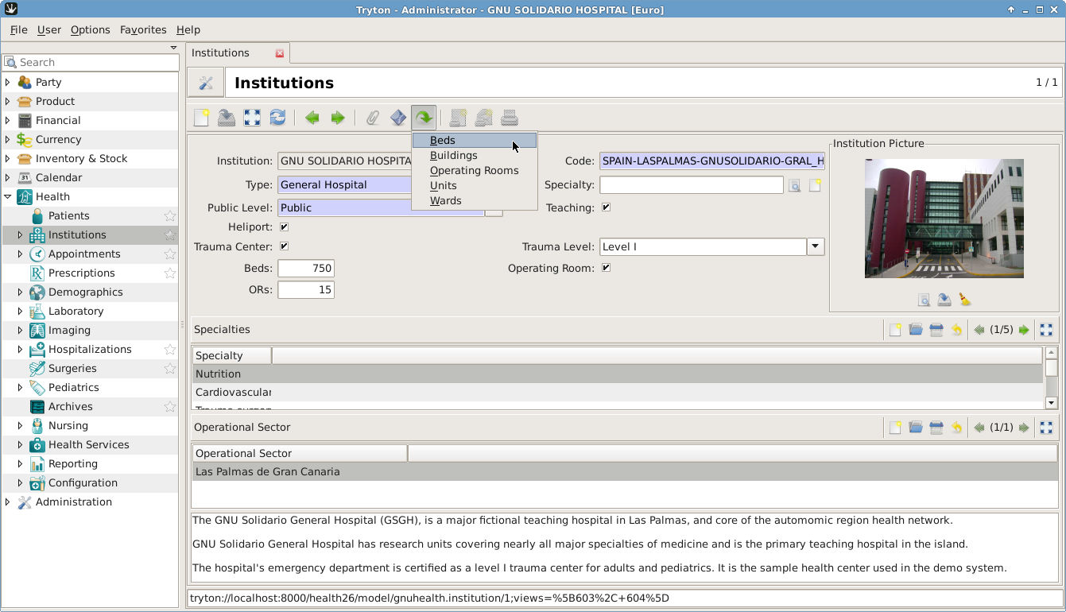
HealthInstitutionsandOperationalSectors
LuisFalcónMartín
GnuSolidario.
CC-BY-NC-SA4.0

Slide 13
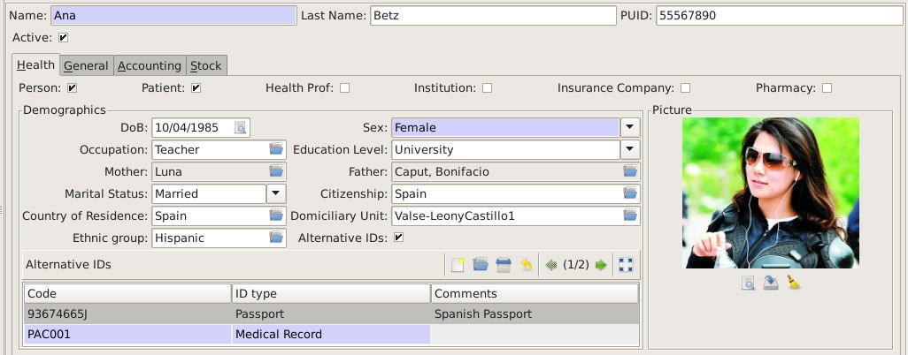
PeopleBeforePatients:Demographics
LuisFalcónMartín
GnuSolidario.
CC-BY-NC-SA4.0

Slide 14
health.gnu.org
MedicalPracticeand HealthCenterManagement
LuisFalcónMartín
GnuSolidario.
CC-BY-NC-SA4.0

Slide 15
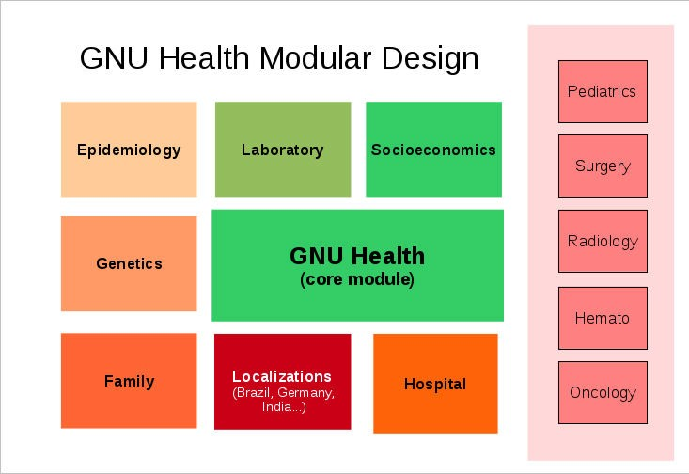
Modularity
LuisFalcónMartín
GnuSolidario.
CC-BY-NC-SA4.0

Slide 16
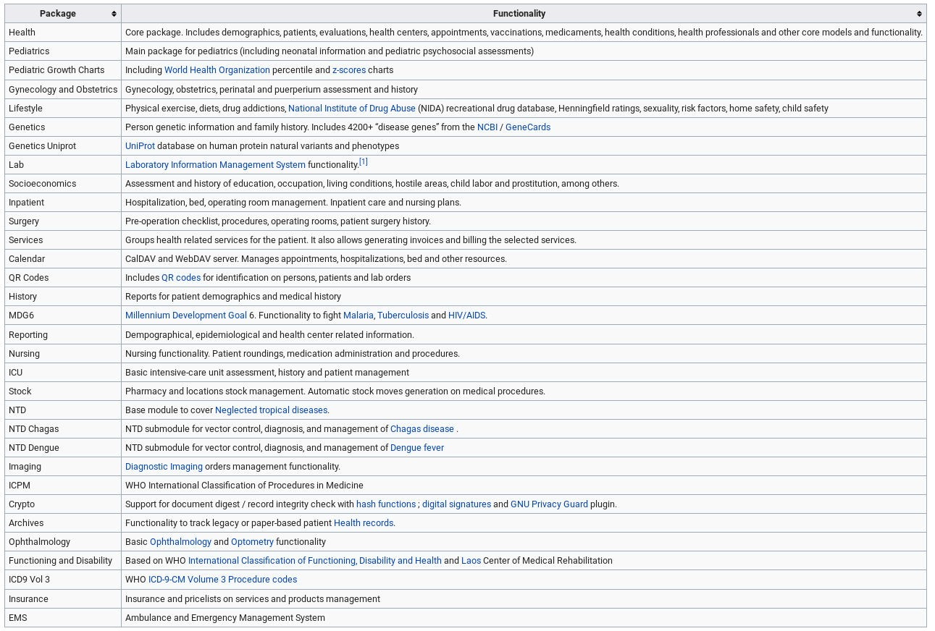
Some of current packages
LuisFalcónMartín
GnuSolidario.
CC-BY-NC-SA4.0

Slide 17
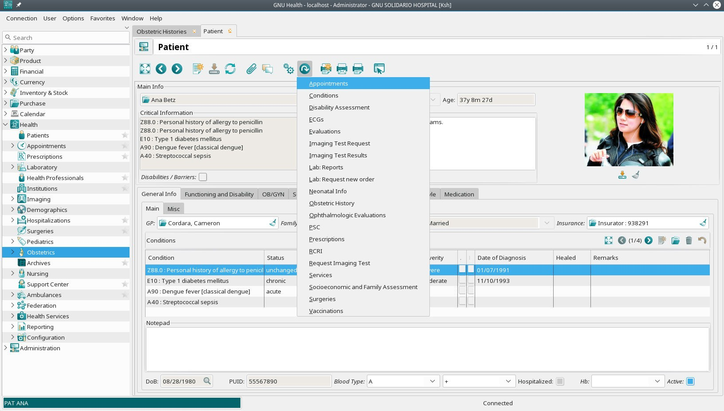
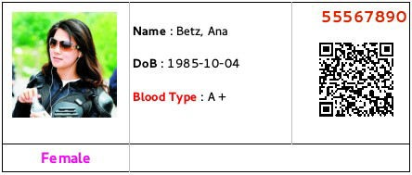
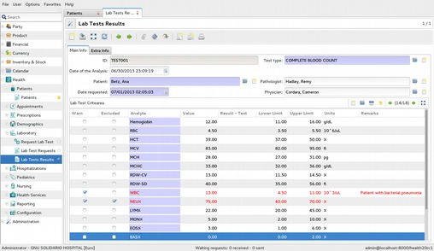
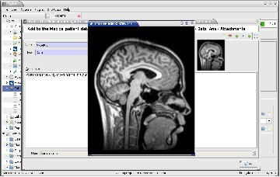
PatientManagement
Critical Info : T1D
LuisFalcónMartín
GnuSolidario.
CC-BY-NC-SA4.0

Slide 18
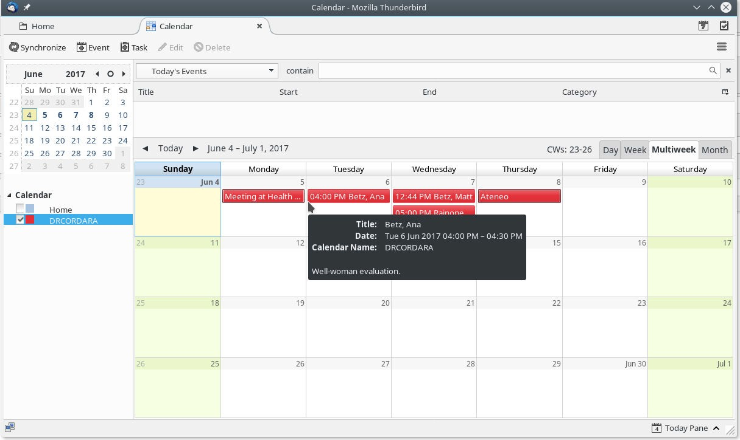
Calendarfunctionality
LuisFalcónMartín
GnuSolidario.
CC-BY-NC-SA4.0

Slide 19


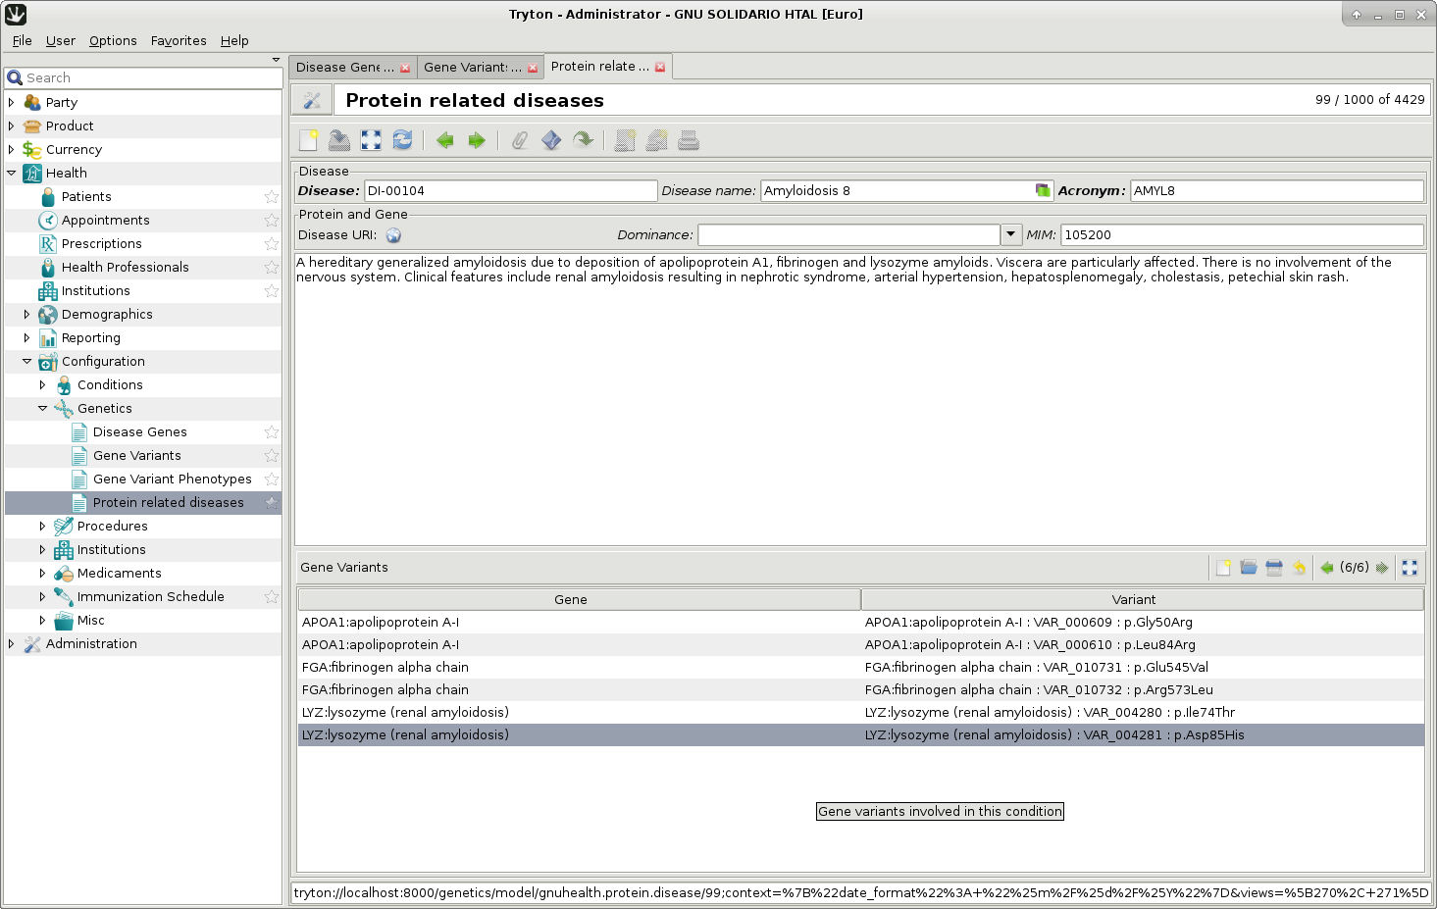
BioinformaticsandPrecisionMedicine
Linking clinicians with research
Personal genetic information & family history Work with Uniprot
Protein related diseases
Gene Natural Variants & phenotypes
GNU Health Federation to interact with scientific community
LuisFalcónMartín
GnuSolidario.
CC-BY-NC-SA4.0

Slide 20

GNULIMS
Laboratory Information System for HealthCare and Biomedicine
LuisFalcónMartín
GnuSolidario.
CC-BY-NC-SA4.0

Slide 21
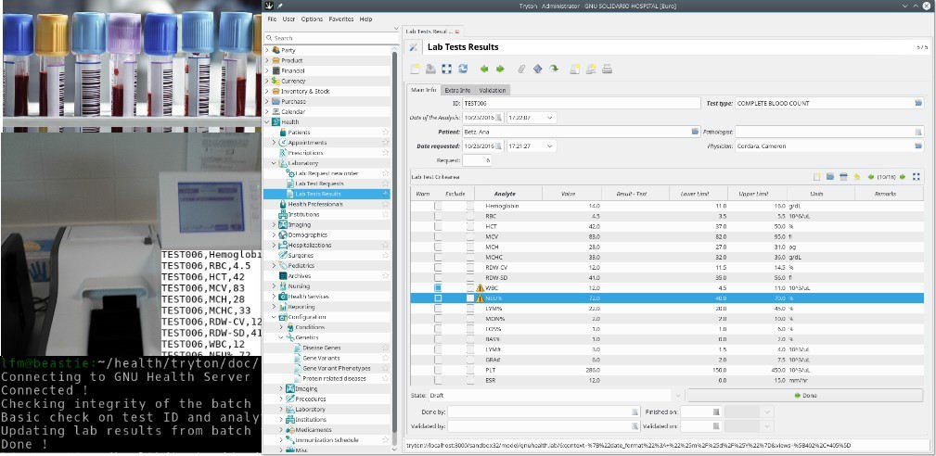
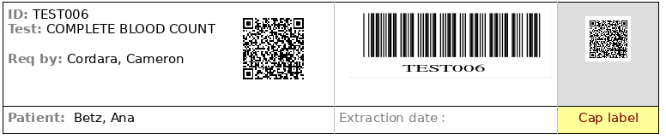
GNULIMS:InteroperabilityandInterfaces
LuisFalcónMartín
GnuSolidario.
CC-BY-NC-SA4.0

Slide 22

DxImaging
GNUHealth
PACSserver
Canstoretheimage,metadata orDICOMDIRlocation
LuisFalcónMartín
GnuSolidario.
CC-BY-NC-SA4.0

Slide 23
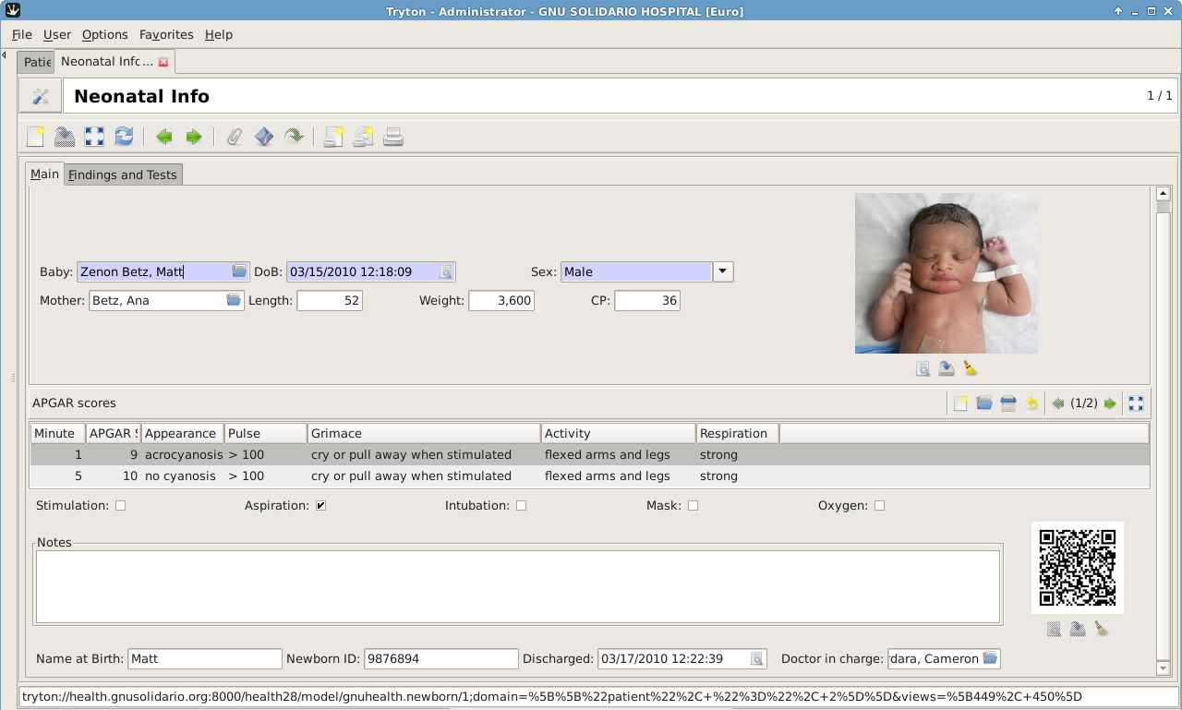
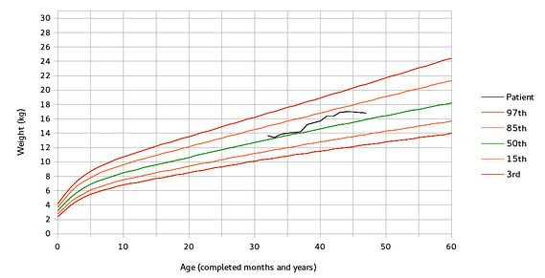
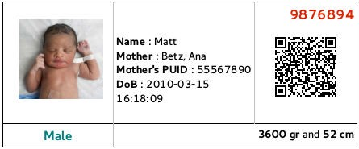
Obstetrics&Pediatrics
PreconceptionandPrenatalCareGeneticRisksandcounseling Obstetricevaluations/imaging Nutritionandgrowthcharts Socioeconomics
Neonatology Immunizations
FamilyFunctionalityandAffectionlevel PsychosocialRisk(Mas GeneralHospitalPSC)
LuisFalcónMartín
GnuSolidario.
CC-BY-NC-SA4.0

Slide 24
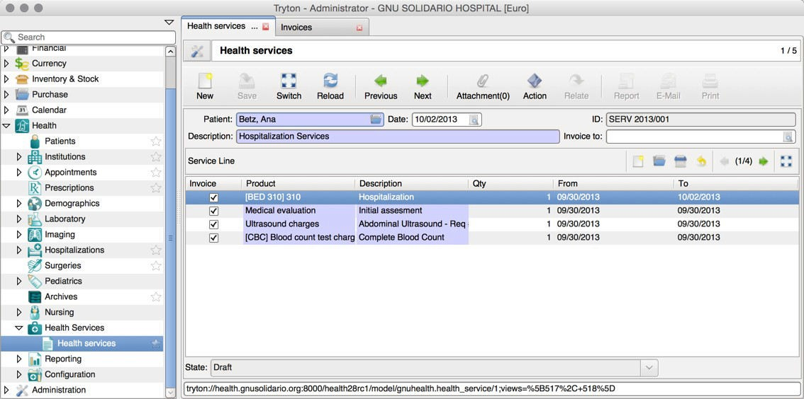
Health Services, Billing / Invoicing
LuisFalcónMartín
GnuSolidario.
CC-BY-NC-SA4.0

Slide 25
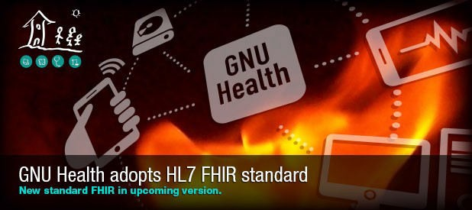
Interoperability
LuisFalcónMartín
GnuSolidario.
CC-BY-NC-SA4.0

Slide 26
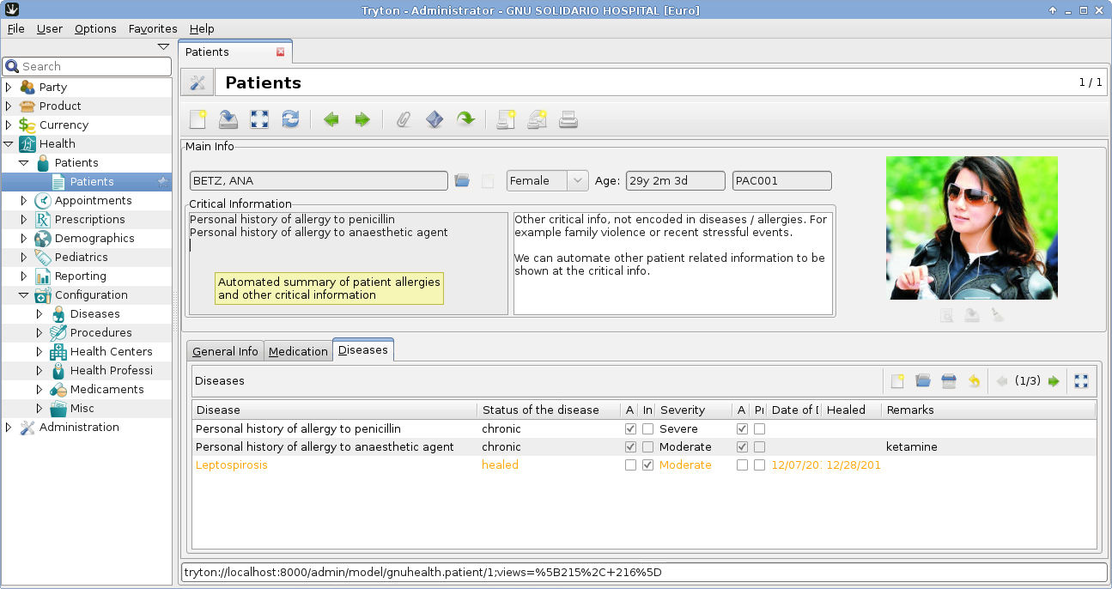
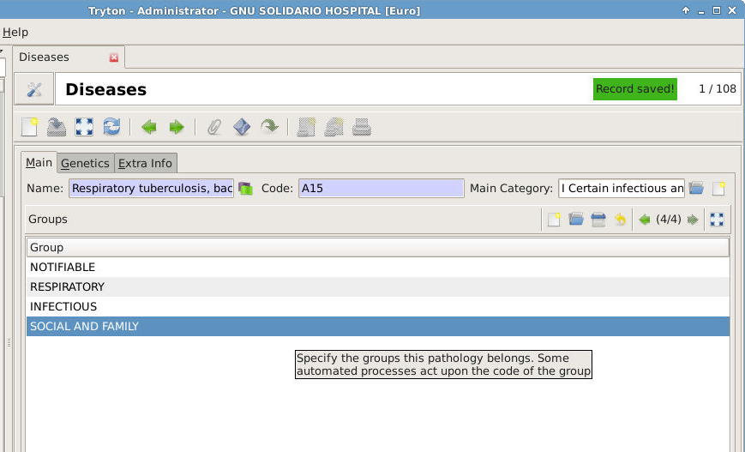
DiseaseGroups
Tuberculosis example
Automatic triggers
Patient Critical Info Reporting
LuisFalcónMartín
GnuSolidario.
CC-BY-NC-SA4.0

Slide 27
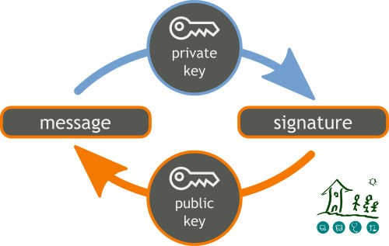
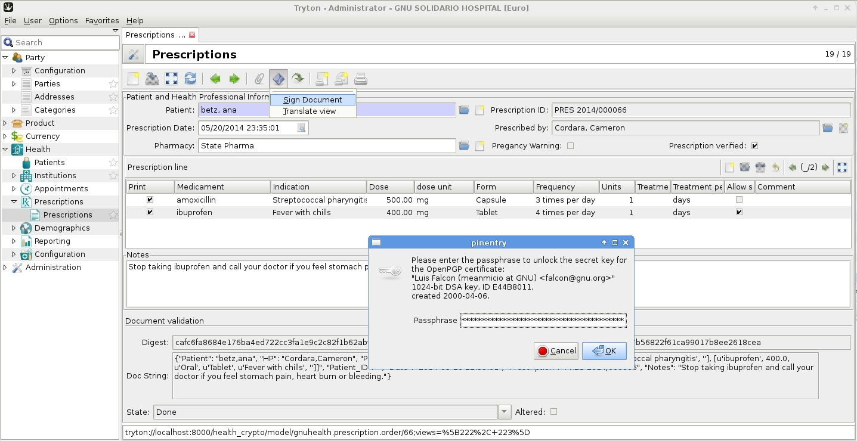
DigitalSignatures&ePrescriptions
Digitally sign documents and medical acts GNUPrivacyGuard(GNUPG)Integration Authenticity, accountability & non-repudiation Documentvalidation
ePrescriptions Evaluations / Encounters
Birth and death certificates Lab Tests, ...
LuisFalcónMartín
GnuSolidario.
CC-BY-NC-SA4.0

Slide 28
health.gnu.org
Tools for the
Health Authorities
LuisFalcónMartín
GnuSolidario.
CC-BY-NC-SA4.0

Slide 29
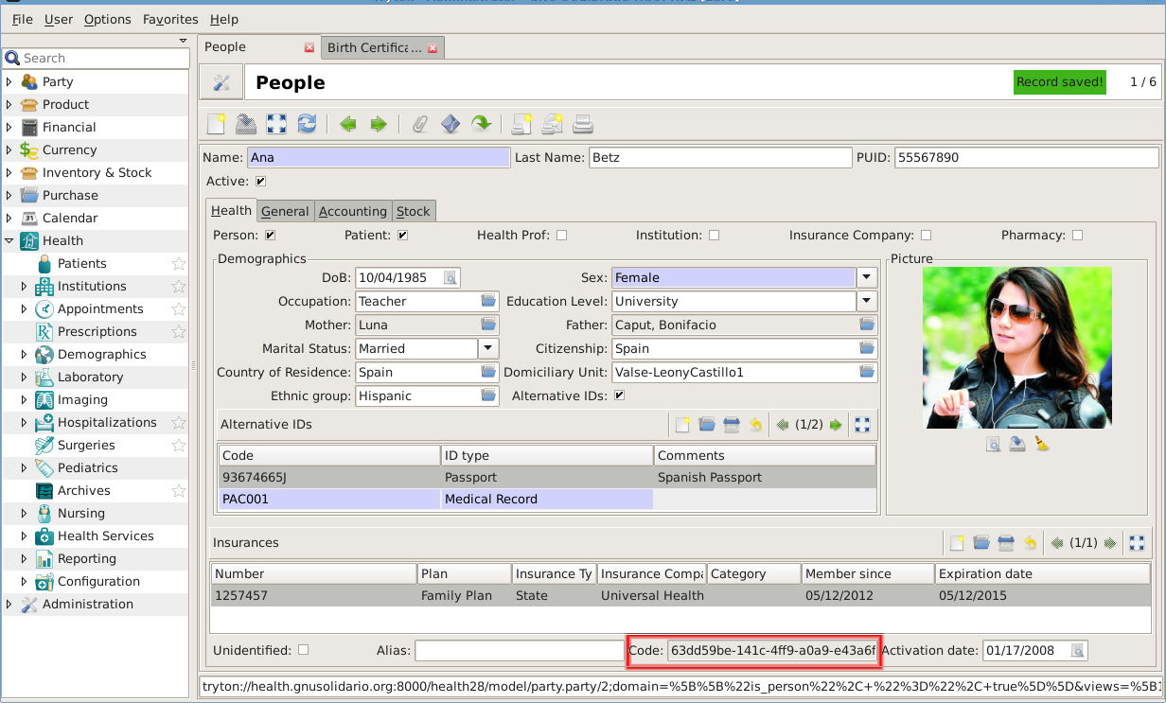
Oneperson,onehistory:PUID
63dd59be-141c-4ff9-a0a9-e43a6f754b39-GNU SOLIDARIO HOSPITAL
LuisFalcónMartín
GnuSolidario.
CC-BY-NC-SA4.0

Slide 30
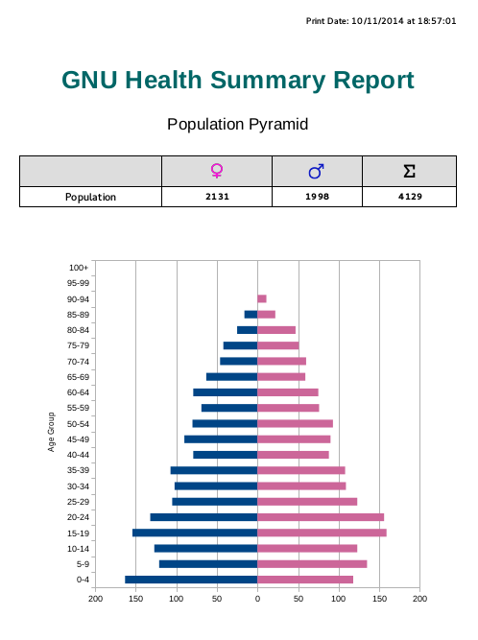
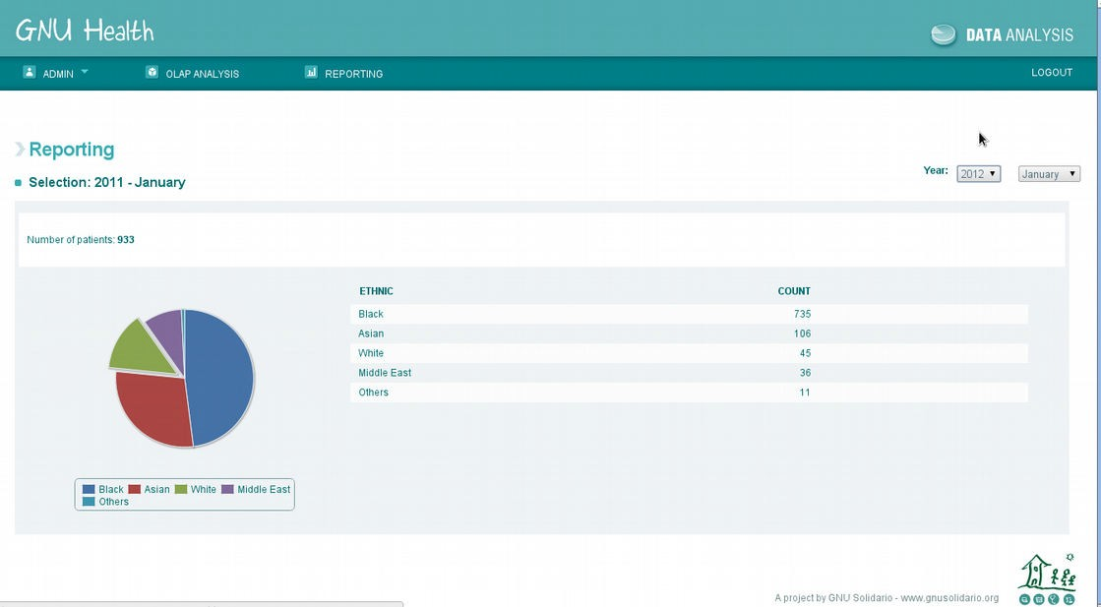
Demographics,Epidemiology,EarlyWarning
Data aggregation Demographics
People without health coverage
Vital Records Sytem Outbrake early warning Geolocalization (OSM) Notifiable diseases
LuisFalcónMartín
GnuSolidario.
CC-BY-NC-SA4.0

Slide 31
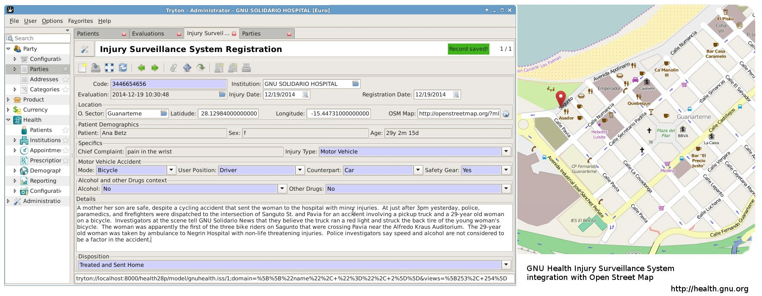
Injury Surveillance System
Records violent injuries (accidents, robberies, self harm, sexual assaults,... ) Georeferenced
ICD 10 encoded
Contextual information (place, time, subjects involved, … ) Thanks to Jamaica MoH !
LuisFalcónMartín
GnuSolidario.
CC-BY-NC-SA4.0

Slide 32
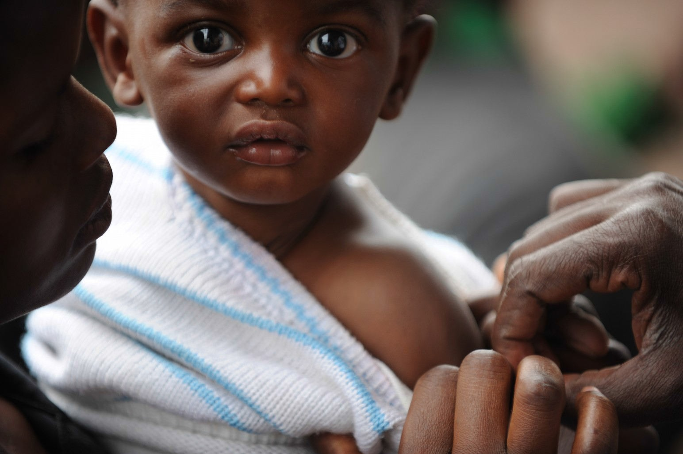
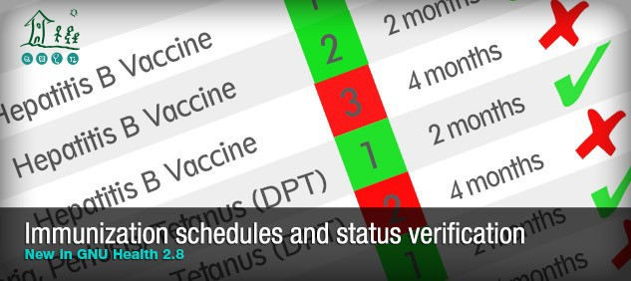
HealthCampaigns
Personalized campaigns (age, sex, social conditions, … )
Immunization status of the population Risk groups (obesity, diabetes, … )
LuisFalcónMartín
GnuSolidario.
CC-BY-NC-SA4.0

Slide 33

GNU Health embedded
LuisFalcónMartín
GnuSolidario.
CC-BY-NC-SA4.0

Slide 34
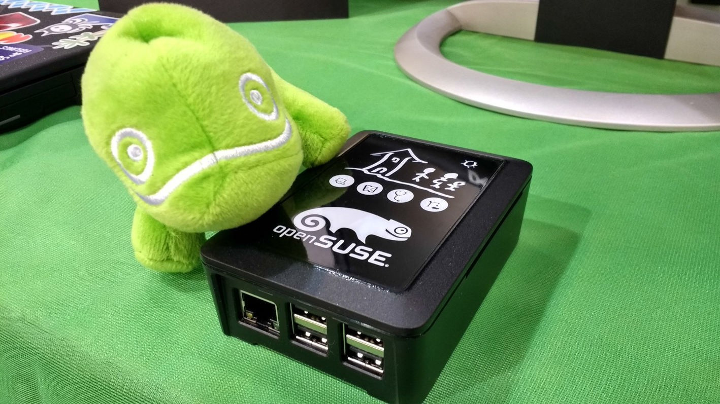
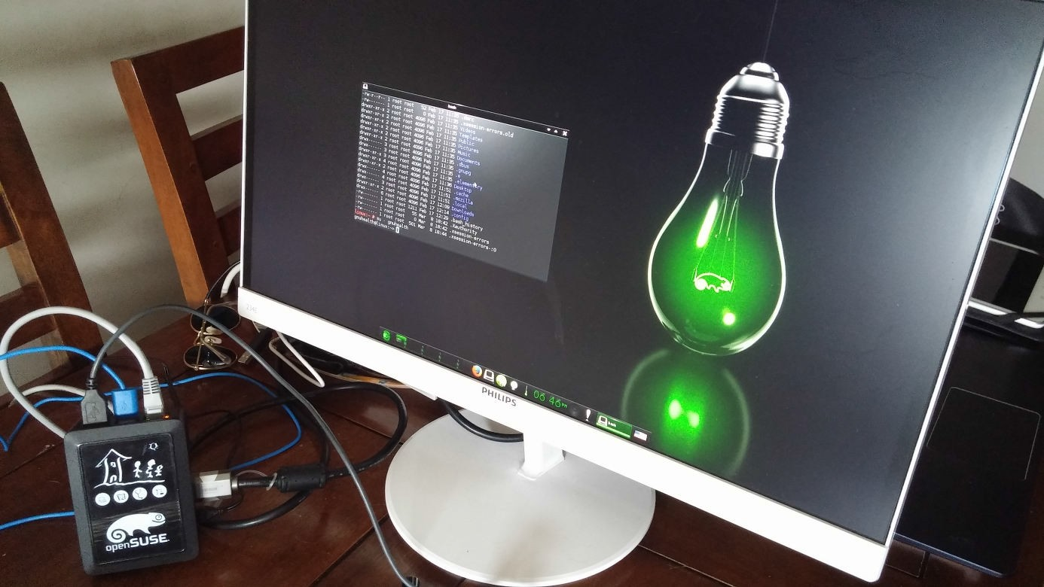
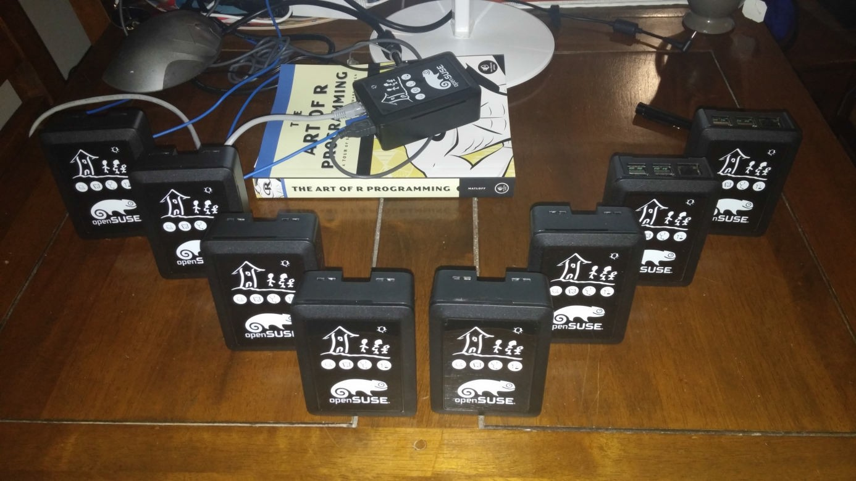
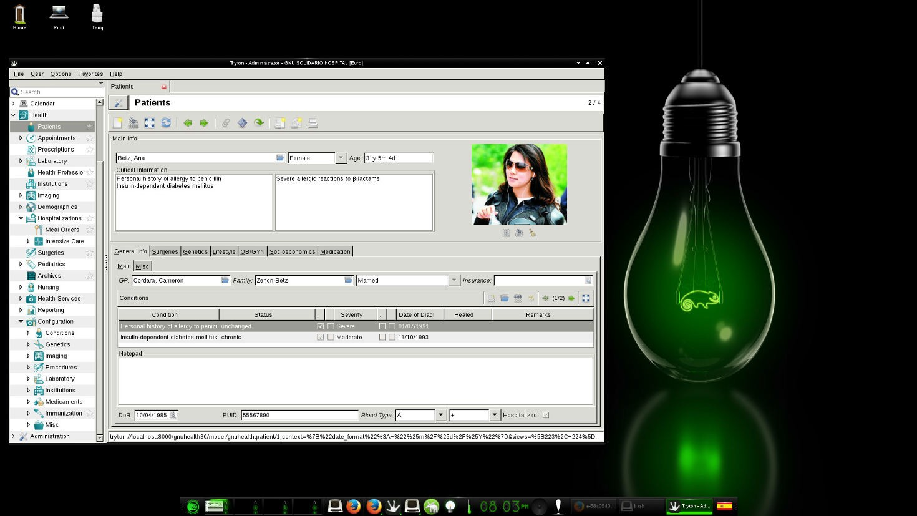
GNU Health & Raspberry Pi
Thanks openSUSE !
LuisFalcónMartín
GnuSolidario.
CC-BY-NC-SA4.0

Slide 35

MyGNUHealth(3.4)
LuisFalcónMartín
GnuSolidario.
CC-BY-NC-SA4.0

Slide 36


MyGNUHealth(3.4)
Demographics Appointments Telemedicine
BMI
Excercise Vitals
Blood Glucose levels
Nutrition Socioeconomics
Health History
LuisFalcónMartín
GnuSolidario.
CC-BY-NC-SA4.0

Slide 37
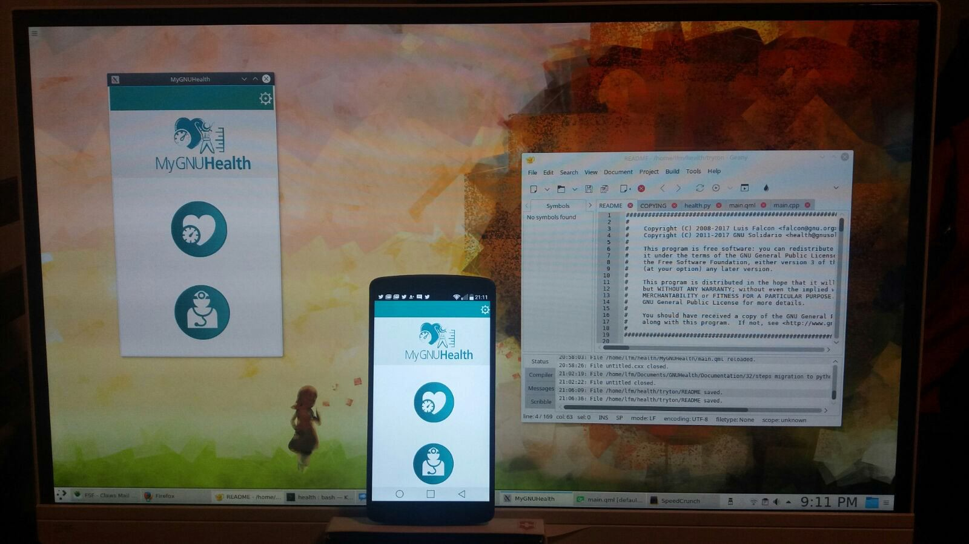
Mobile and Desktop application
LuisFalcónMartín
GnuSolidario.
CC-BY-NC-SA4.0

Slide 38
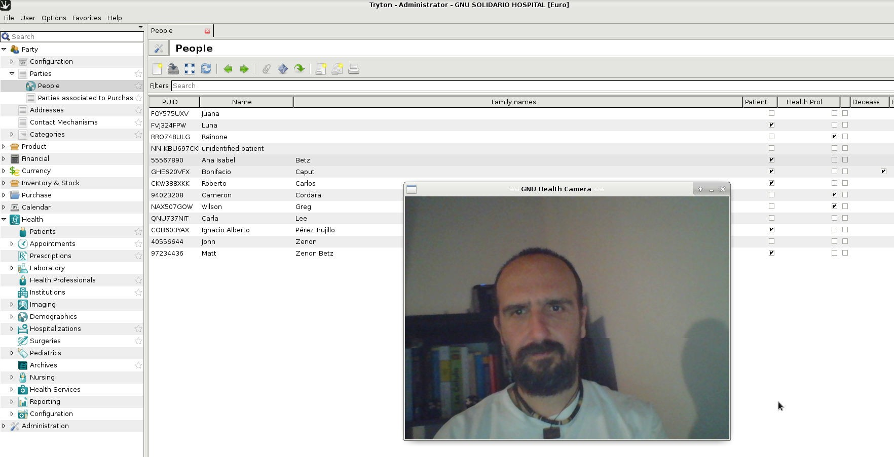
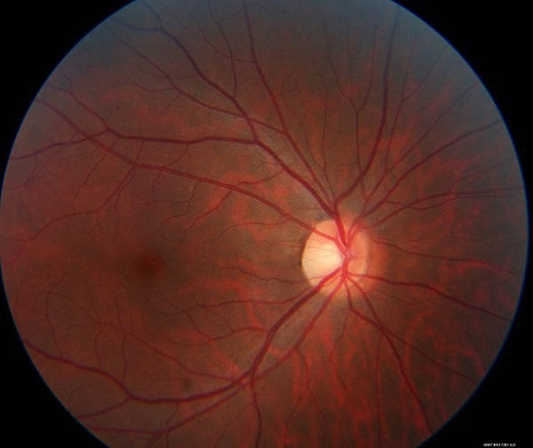
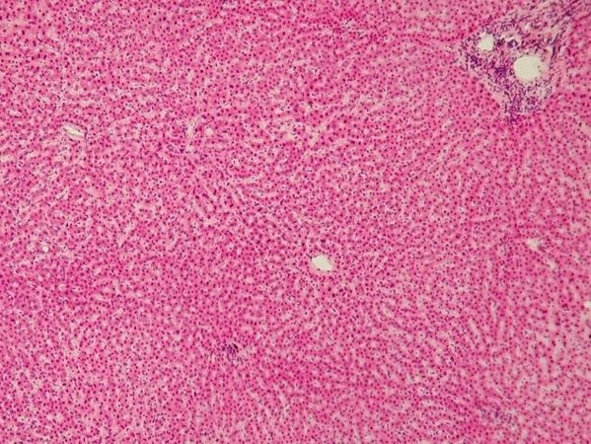
GNUHealthCamera
Person / Patient Registration DUs Surveys
Dx Imaging Histology / Pathology
...
LuisFalcónMartín
GnuSolidario.
CC-BY-NC-SA4.0

Slide 39

GNUHealthFederation
LuisFalcónMartín
GnuSolidario.
CC-BY-NC-SA4.0

Slide 40
















GNUHealthFederation
LuisFalcónMartín
GnuSolidario.
CC-BY-NC-SA4.0

Slide 41
GNUHealthFederation
Autonomous Distributed Heterogeneous Scalable
High availability Secure
LuisFalcónMartín
GnuSolidario.
CC-BY-NC-SA4.0

Slide 42
health.gnu.org
GNUHealth Planet
LuisFalcónMartín
GnuSolidario.
CC-BY-NC-SA4.0

Slide 43

Thank you, geeko!
Active GNU Health member
Ships GNU Health package
Sponsor (GNUHealthCon)
Donation of Raspberry Pis
Great, friendly community
LuisFalcónMartín
GnuSolidario.
CC-BY-NC-SA4.0

Slide 44
The Users

Slide 45
The difficult part - Users
The issue with Free Software Projects
We dont know our Users!
(at least for the most part)
Notes:
No need to register, sign contracts or pay fees
No home-phone
So how to measure installations/ users?
Only parts of projects known covering wide range of use

Slide 46
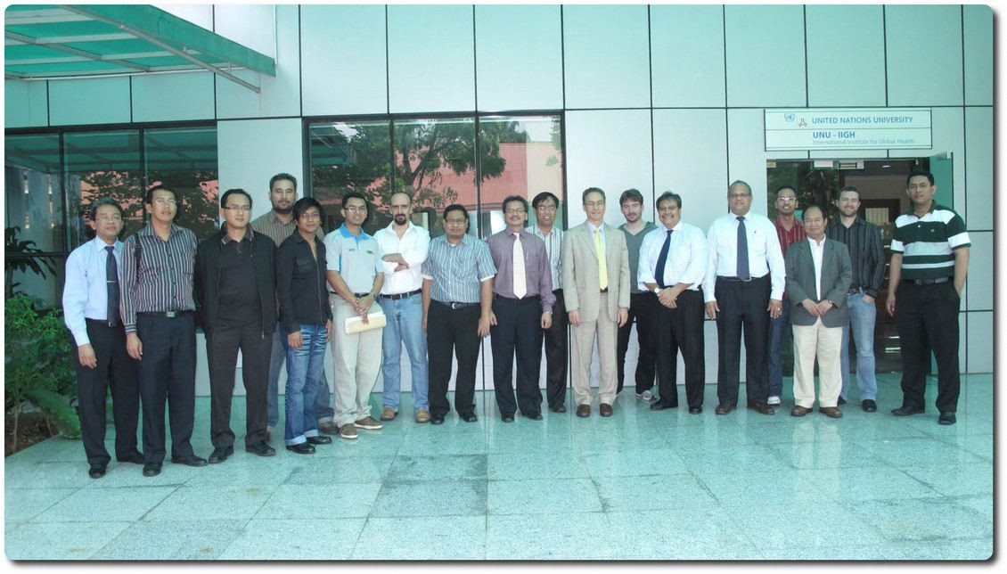





GNUHealthandtheAcademia
UnitedNationsUniversity,KualaLumpur, Malasia
UniversityofEntreRios,Argentina
Harvard/MIT,Boston,UnitedStates Univ.Matanzas,Cuba
LuisFalcónMartín
GnuSolidario.
CC-BY-NC-SA4.0
Univ.Palermo,Italy

Slide 47




Universities…join the GNUHealth Alliance!
LuisFalcónMartín
GnuSolidario.
CC-BY-NC-SA4.0

Slide 48
Users: Known implementations
Notes:
Red – the ones we know
Yellow – on the way resp. planned

Slide 49




GNUHealthinArgentina
LuisFalcónMartín
GnuSolidario.
CC-BY-NC-SA4.0

Slide 50


Argentina Public Health System
Province Entre Rios
Since 2012, 8+ installations
Primary Care/Day Care/Hospital
Notes:
"Technology for the administration of health care“
Objective: "Promote the use of technologies based on free software for data processing and health information in organizations related to public health"

Slide 51



UniversidadNacionaldeEntreRios,Argentina
LuisFalcónMartín
GnuSolidario.
CC-BY-NC-SA4.0

Slide 52

Daycare for homeless, refugees and persons without health insurance, Germany
Runs GNU Health since 2017
(migrated from openEMR)
Daycare center
4 nurses, 8 doctors
Monthly event with meals, medical and consultingservices (debt, drug, etc)
40-80 visitors per event, 10-15 asking for med care
Budget: 0
Notes:
The „Malteser Pflasterstube“ is a network of volunteers which offers medical care to homeless people or people without heath insurance.
Once a month the network organizes a meal with medical care, consulting services (debt, alcoholism, drug addiction) and other services (hair cut and others). Everything is free and discrete.
On such a monthly event there are between 40 and 80 visitors. 10 to 15 are asking for medical care.
The network gives 24/7 support if someone calls the emergency number and asks for help.
As software we used for three years OpenEMR and changed 2017 to GNU Health.

Slide 53




GNUHealthandInsolafrica
LuisFalcónMartín
GnuSolidario.
CC-BY-NC-SA4.0

Slide 54


GNUHealth&WorldHealthOrganization
MDG6 : Malaria, TB, HIV
Essential list of medicines Neglected Tropical Diseases
ICD-10
ICPM
MDG4 : Reduce Child mortality
Immunization schedules Pediatric growth charts
LuisFalcónMartín
GnuSolidario.
CC-BY-NC-SA4.0

Slide 55

GNUHealth&WorldHealthOrganization
ICD-10
Training sessions with WHO Africa regional officers
LuisFalcónMartín
GnuSolidario.
CC-BY-NC-SA4.0

Slide 56

Sharab Medical Center Gambia
Runs GNU Health since 2016
14 beds
40 professionals
40 patients per day
Moved from GH 2.8 (Ubuntu)
to 3.2 on openSUSE
http://www.sharabclinic.com/
Notes:
GNUhealth 2.8 was first implemented by an outsource in the beginning of 2016, it was not practically functional till an IT staff was available on board on Sep 2016.
Training and putting procedures were on going. updates to versions 3.0 and 3.2 were on openSUSE by packages through support of Dr Axel Braun and It was more responsive than the previous versions on Ubuntu.
Currently the system is absolutely helping us to provide better services efficiently.

Slide 57

Bafia District Hospital Cameroon
GNU Health since 2018
170 beds
110 professionals
50-100 patients per day
3 month prep &
2 month implementation
Notes:
GNU Health was successfully implemented. It took 3 months preparatory works and 2 months deployments.

Slide 58


Cameroon – Public District Hospital
Challenges:
Infrastructure
(Regular power cuts)
low computer literacy
LuisFalcónMartín
GnuSolidario.
CC-BY-NC-SA4.0

Slide 59

Bikop - Cameroon
LuisFalcónMartín
GnuSolidario.
CC-BY-NC-SA4.0

Slide 60

Pakistan,Islamabad
Dr. Akbar Niazi Teaching Hospital (ANTH), a 500-bed hospital in Islamabad
LuisFalcónMartín
GnuSolidario.
CC-BY-NC-SA4.0

Slide 61

Dr. Akbar Niazi Teaching Hospital,
Islamabad, Pakistan
Runs GNU Health since 2016
500 beds
150 professionals
250 patients per day
Budget: 0 (Inhouse team)
www.danthospital.com
Notes:
Customized and implemented following modules one by one:
Outpatient registration (OPD)
Appointments, Patient Evaluations, Prescriptions, Lab
Inhouse Team = Education

Slide 62

Red Cross Mexico / Cruz Roja
Over 300,000 visits / year
LuisFalcónMartín
GnuSolidario.
CC-BY-NC-SA4.0

Slide 63


Red Cross Mexico
Runs GNU Health since 2017 in 3 locations in Veracruz, Boca del Rio
24 consulting rooms
36 beds
14 ambulances
340 professionals
850 patients per day
Notes:
Multi-site use

Slide 64
Red Cross Mexico - before
Accounting system does not comply all the needs
No system for inventory control
Only physical medical records
Hospitalization system does not comply all the needs
Good system for emergency calls control but, completly independet to the others
...and some more issues
Manual work
No control
Very difficult to locate clinical history for patients
Manual work
Manual work to transfer information for accounting and some statistics
Notes:
Similar issues on each implemementation

Slide 65



Red Cross Mexico - after
Consulting appointments
Accounting
Surgeries
Inventory Control
Purchase
Electronic Medical Records
Pharmacy (POS)
Hospitalizations
Imagenology
DB
Laboratory
Cash collection
Emergencies
Payments
Notes:
Everything under one roof
Ambulance system was developed in this project, now in the GNU Health standard

Slide 66




Mexico
LuisFalcónMartín
GnuSolidario.
CC-BY-NC-SA4.0

Slide 67


GNUHealth at the Government of Jamaica
Started as a joint project between Government of Jamaica Ministry of Health and GNU Solidario
Local team
Sustainability and independence
Unique ID for each individual across the country
GNU/Linux on both workstations and servers
LuisFalcónMartín
GnuSolidario.
CC-BY-NC-SA4.0

Slide 68

350+“GNU”Healthfacilitiesnation-wide
LuisFalcónMartín
GnuSolidario.
CC-BY-NC-SA4.0

Slide 69

Center for Medical Rehabilitiation (CMR) Laos
Runs GNU Health since 2014
Service for amputees and rehabilitation
Module for health disability
Notes:
Laos is an asian country surrounded by mainly Thailand in the west and Vietnam in the east

Slide 70

Center for Medical Rehabilitiation (CMR) Laos
Runs GNU Health since 2014
Service for amputees and rehabilitation
Module for health disability
Notes:
During 64-73, B-52 F-aircrafts did 580,000 sorties; Many types of Bombs
two million tons dropped over 2/3 of Laos territory;
30 % of them remain unexploded (unexploded ordnance, UXOs) > WW.II ’s bombing.
Total 148 districts, 42/47 out of poorest districts seriously affected.
Bombing destroyed many villages and displaced hundred thousand of Lao civilians during 9 year period.
Each year there are now just under 50 new casualties, down from 310 in 2008.
Close to 60% of accidents result in death, and 40% of victims are children
Over 25 years on, less than 1% of these munition have been destroyed.

Slide 71




GNUHealthatLaosPublicHealthSystem
LuisFalcónMartín
GnuSolidario.
CC-BY-NC-SA4.0

Slide 72
Mahosot Hospital Vientiane, Laos
Runs GNU Health since 2016
Old & complex building, partly since french colony
600 beds
Completed translation to Lao language
Introduced by same team as CMR

Slide 73

Welcome, AIIMS!
All India Institute of Medical Sciences, AIIMS
Largest publich health hospital in Asia
LuisFalcónMartín
GnuSolidario.
CC-BY-NC-SA4.0

Slide 74

All India Institute of Medical Science
GNU Health implementation in progress
Largest public hospital in Asia
3.500 beds
3.5 Mio examinations/year
70 FTE internal IT staff
openSUSE as backbone

Slide 75
A white spot...
Notes:
Translated to traditional chinese in about three weeks
No feedback about usage

Slide 76








Some cool areas of work
LuisFalcónMartín
GnuSolidario.
CC-BY-NC-SA4.0

Slide 77



Reachout!
LuisFalcónMartín
GnuSolidario.
CC-BY-NC-SA4.0

Slide 78
Community involves humans
Treat them with respect otherwise they may get strange

Slide 79

IWEEE&GNUHealthCon2018
Celebrating 10 years of Freedom and Equity in Healthcare
November 23 -25, Las Palmas, Spain http://www.gnuhealthcon.org
LuisFalcónMartín
GnuSolidario.
CC-BY-NC-SA4.0

Slide 80

See you at GNU Health Con 2018

Slide 81



Healthisanon-negotiablehumanright
http://health.gnu.org
@gnuhealth
LuisFalcónMartín
GnuSolidario.
CC-BY-NC-SA4.0

